Slide 1
Important Topics

Slide 2
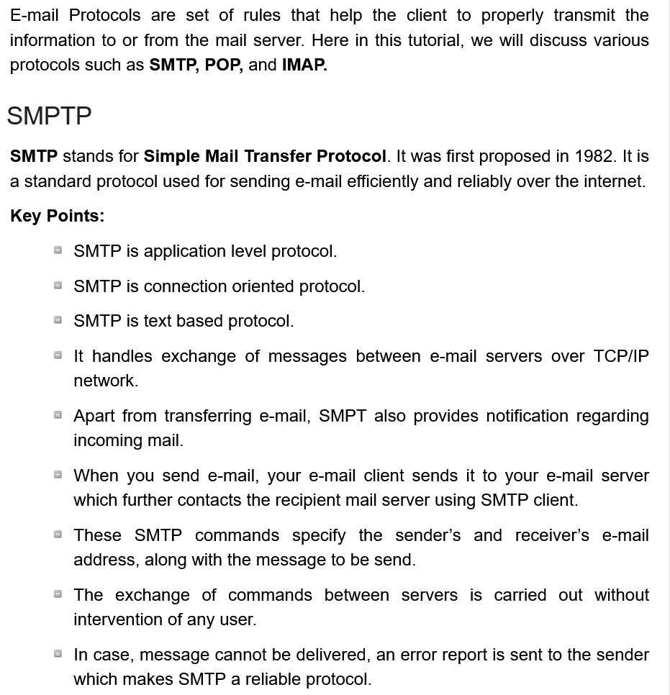

Slide 3
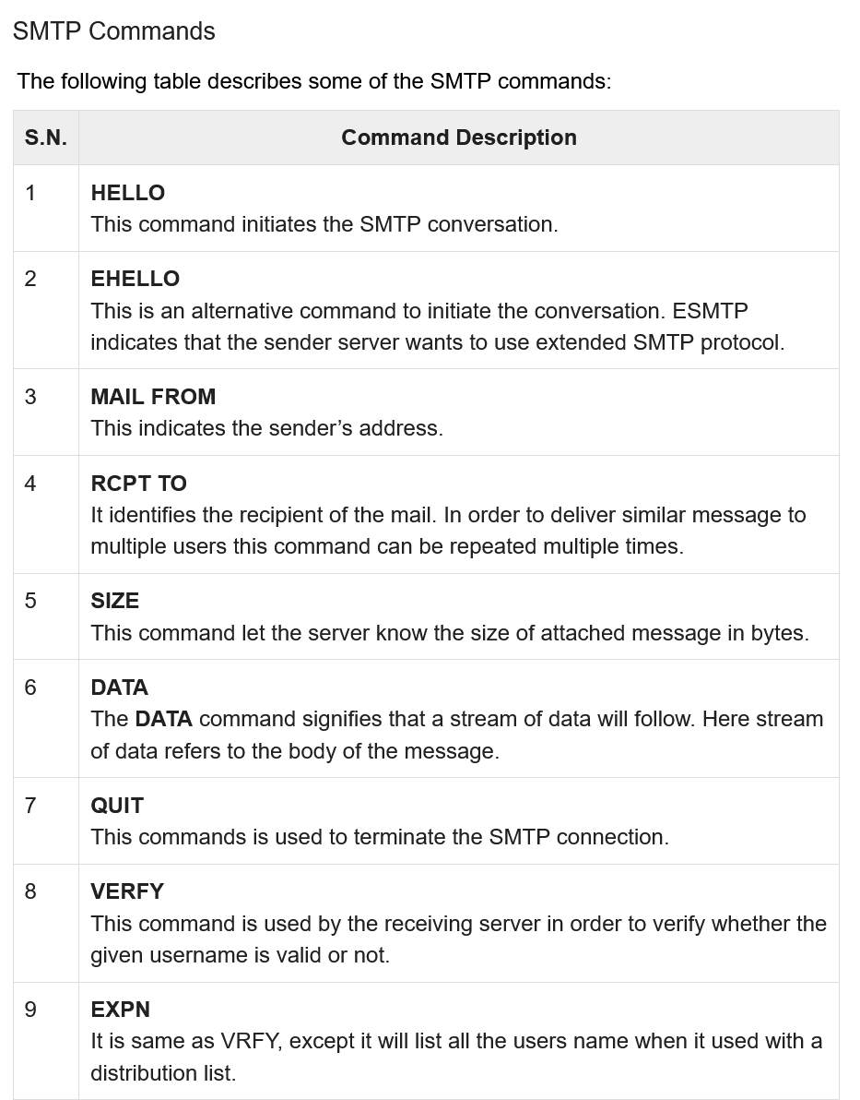

Slide 4
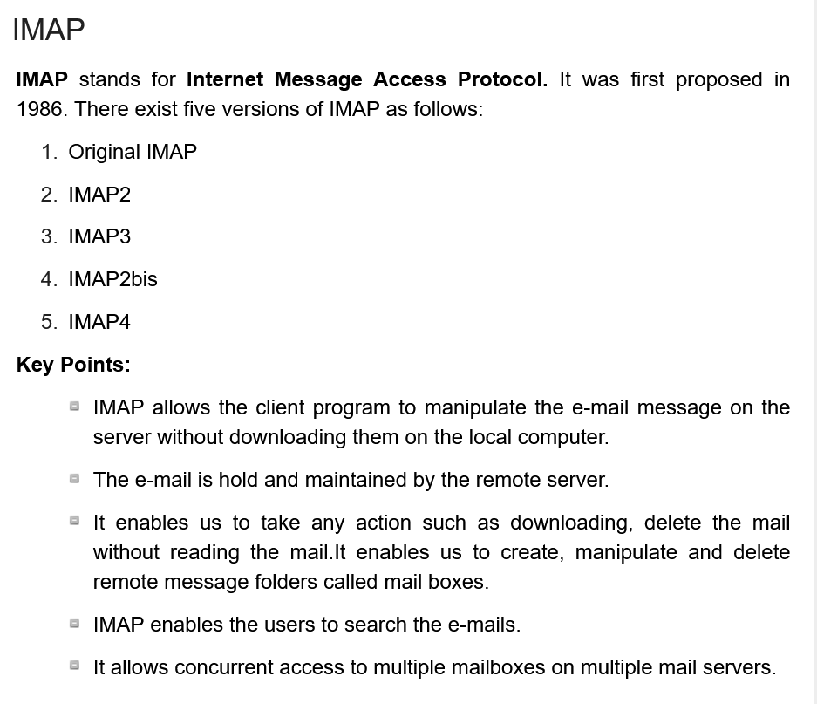

Slide 5
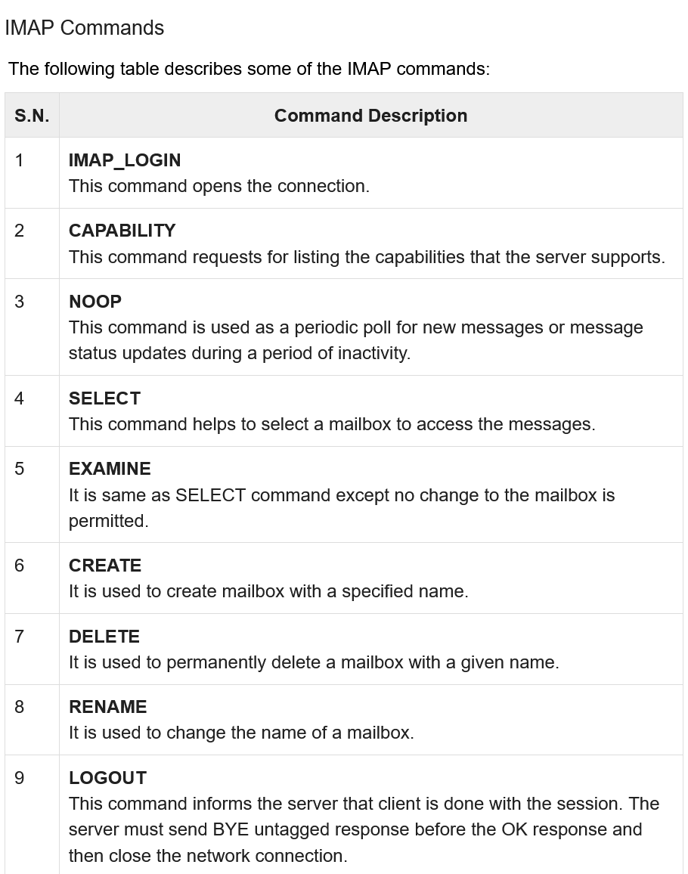

Slide 6
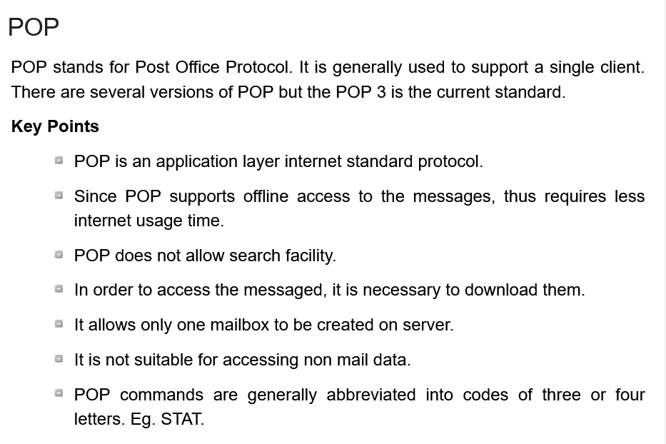

Slide 7
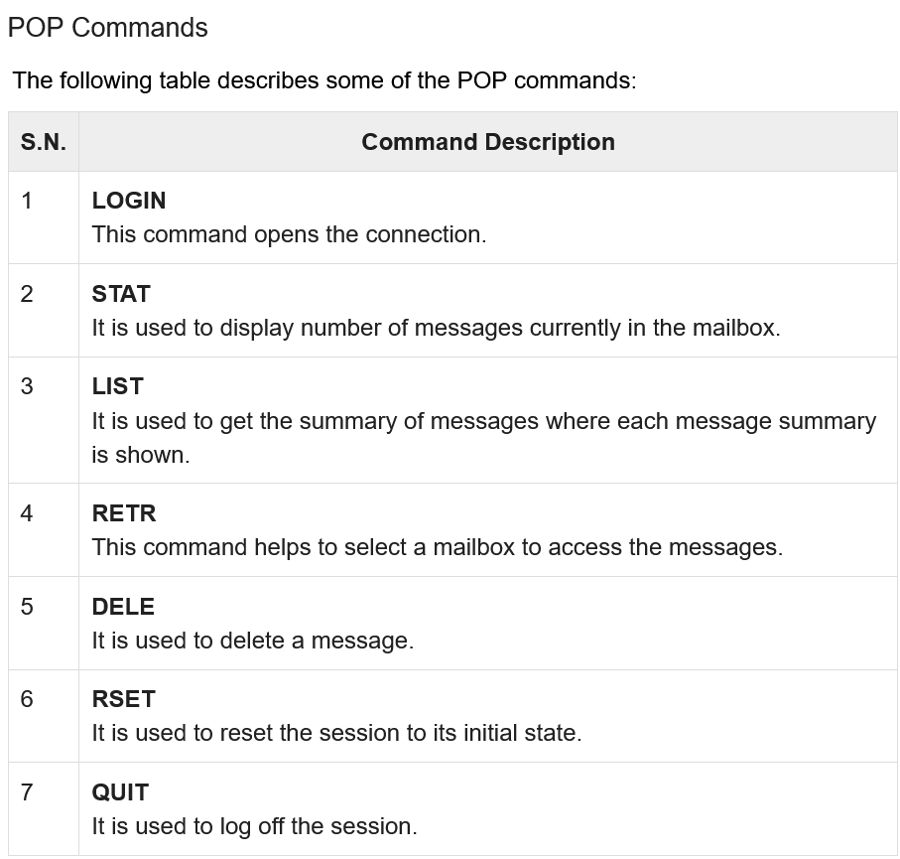

Slide 8
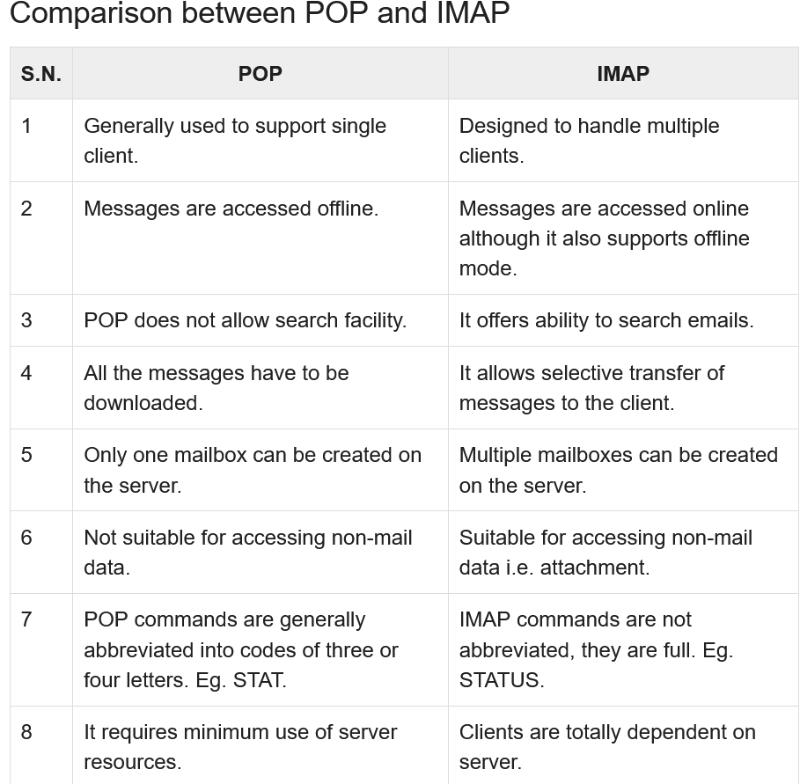

Slide 9
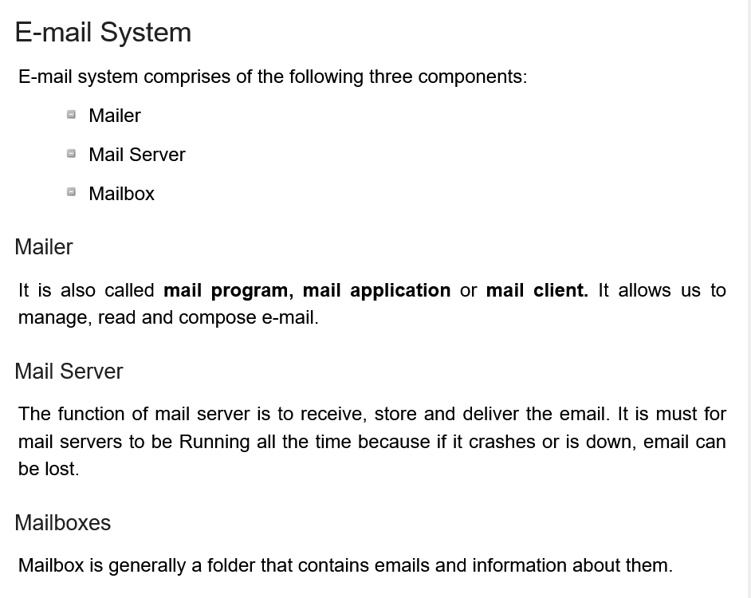

Slide 10
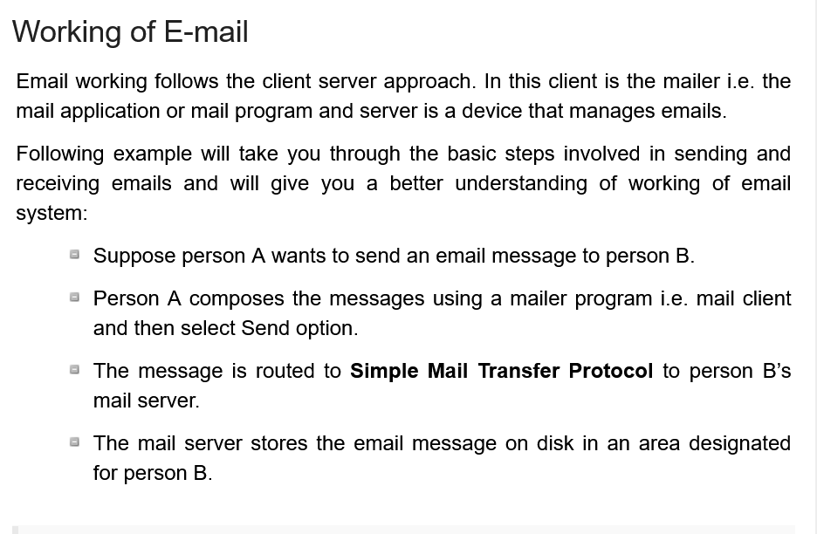

Slide 11
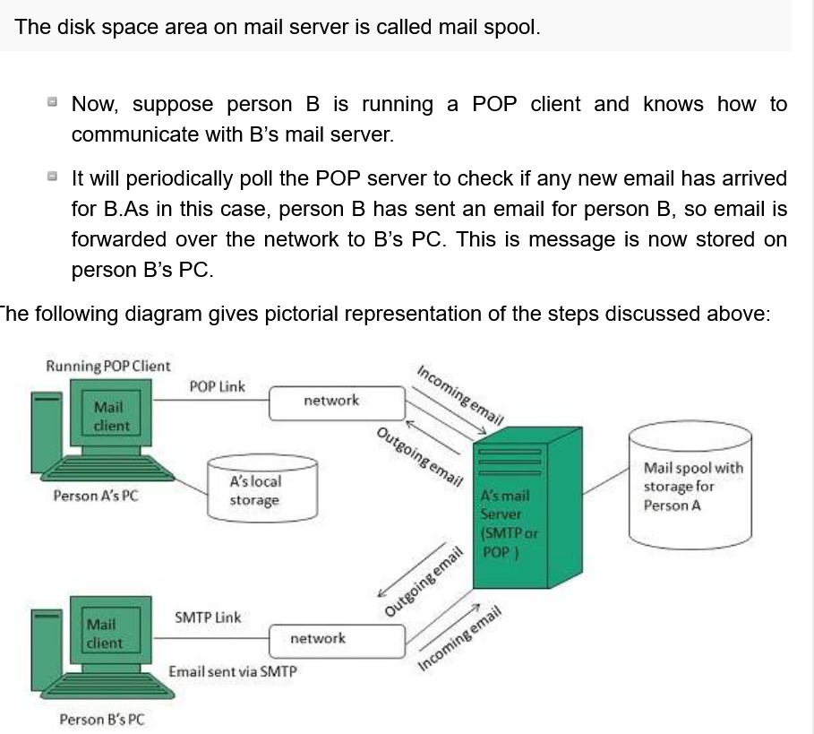

Slide 12
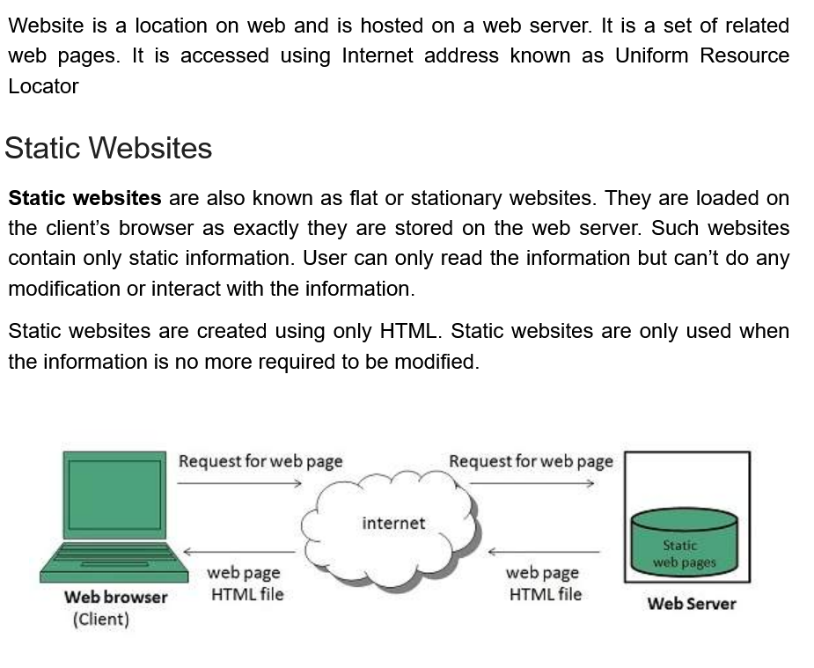

Slide 13
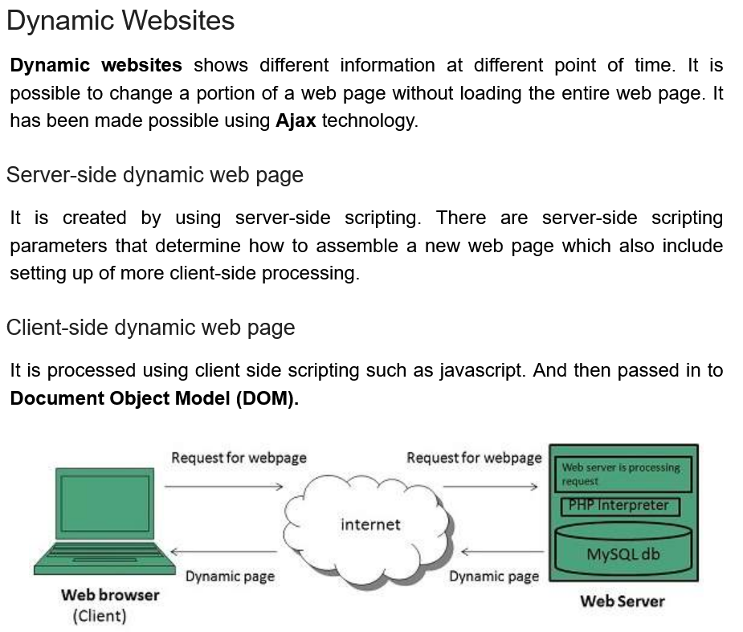

Slide 14
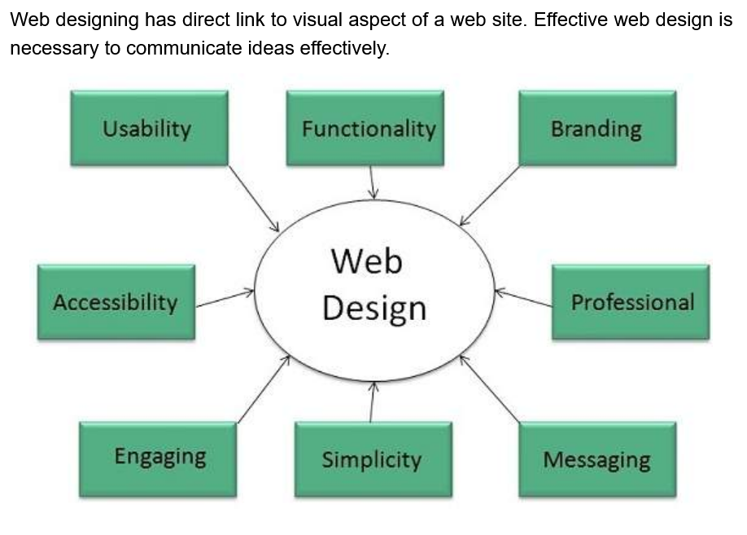

Slide 15
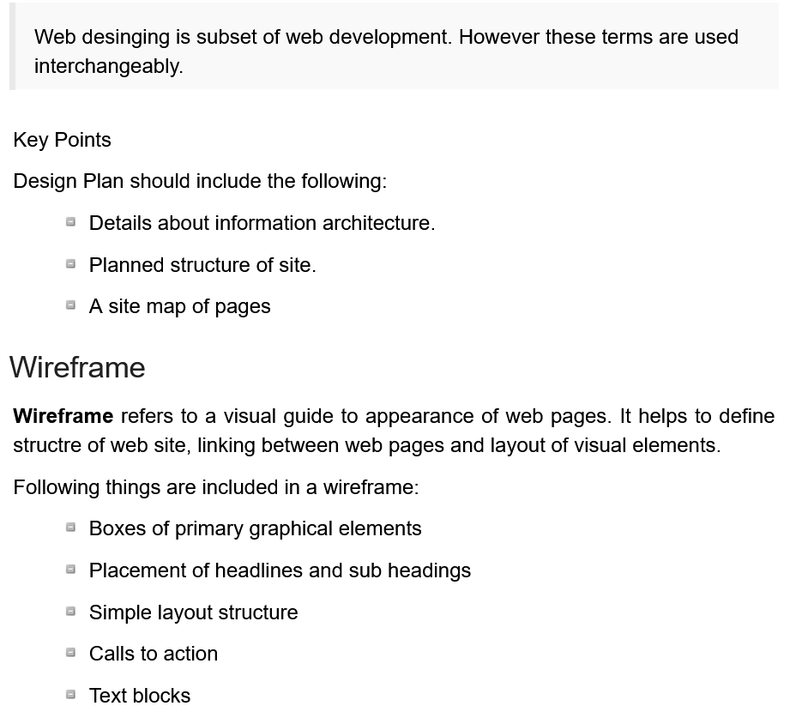

Slide 16
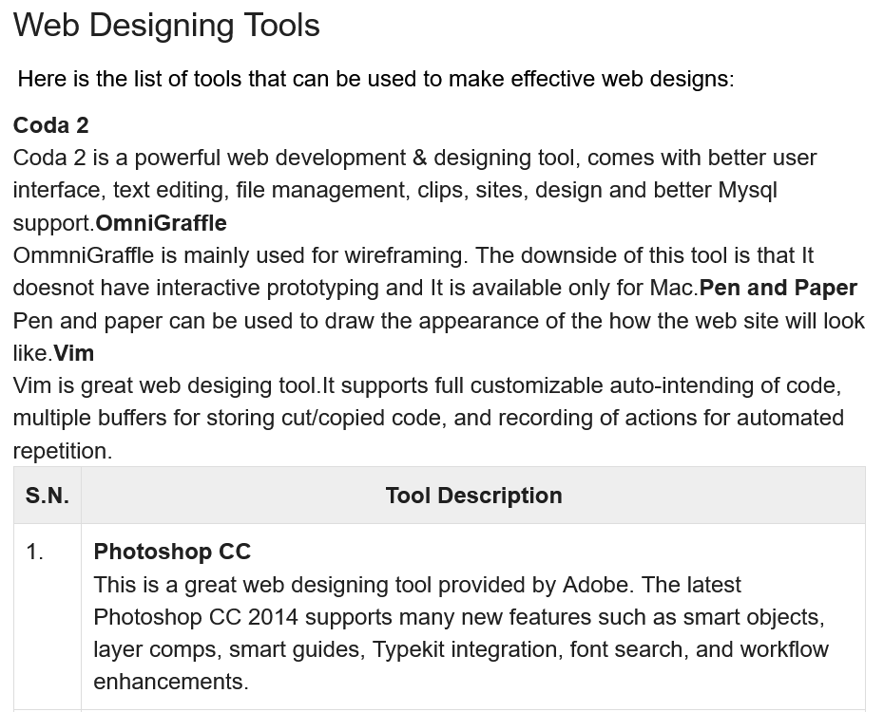

Slide 17
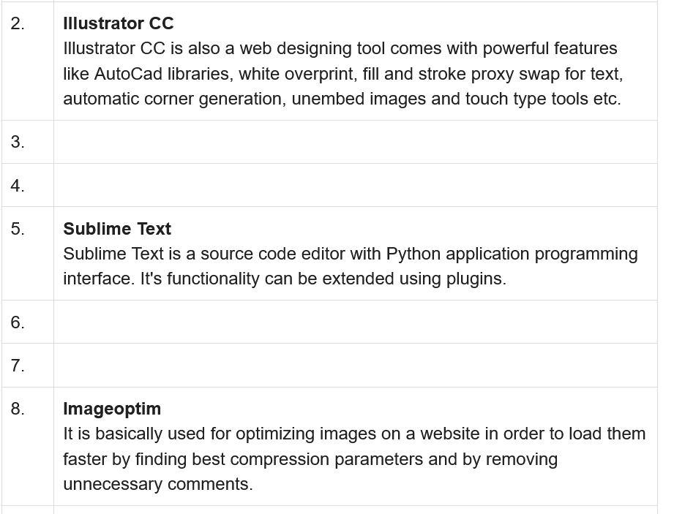

Slide 18
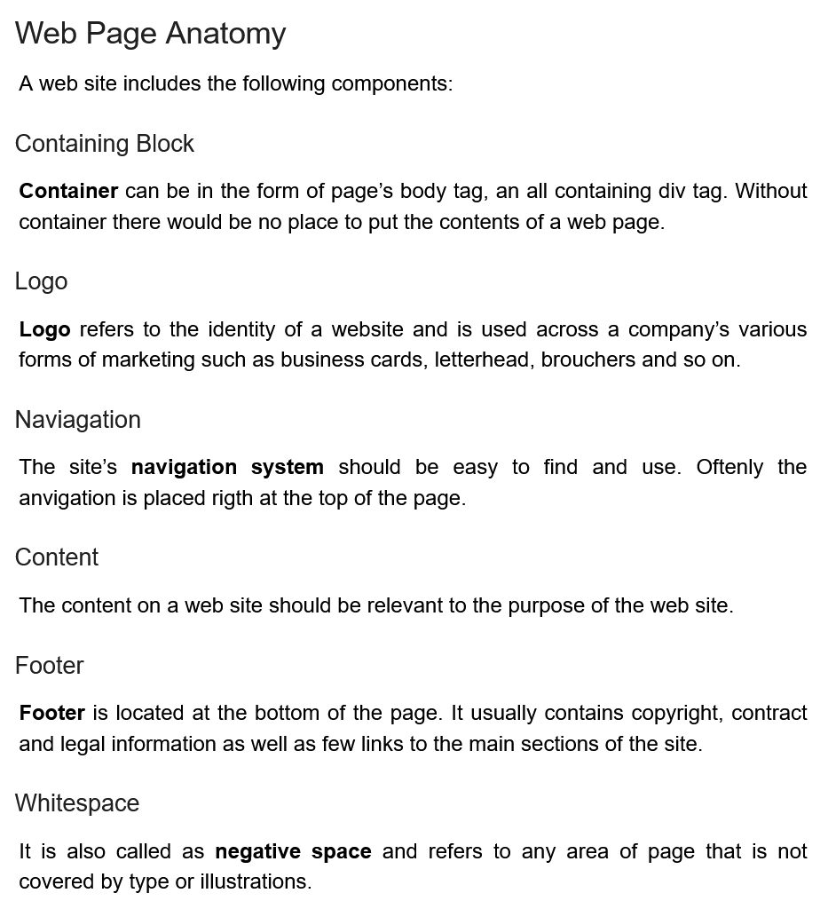

Slide 19
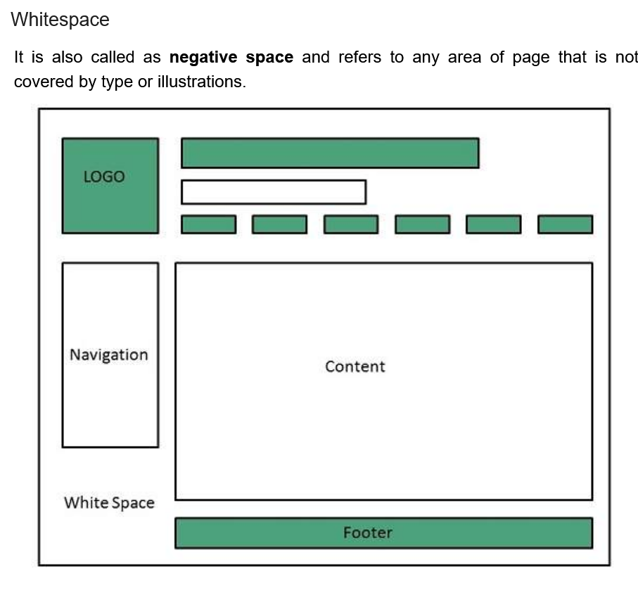

Slide 20
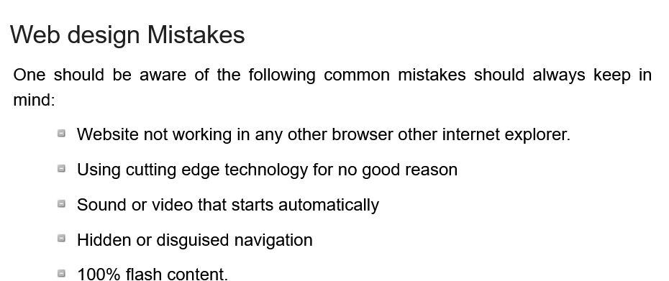

Slide 21
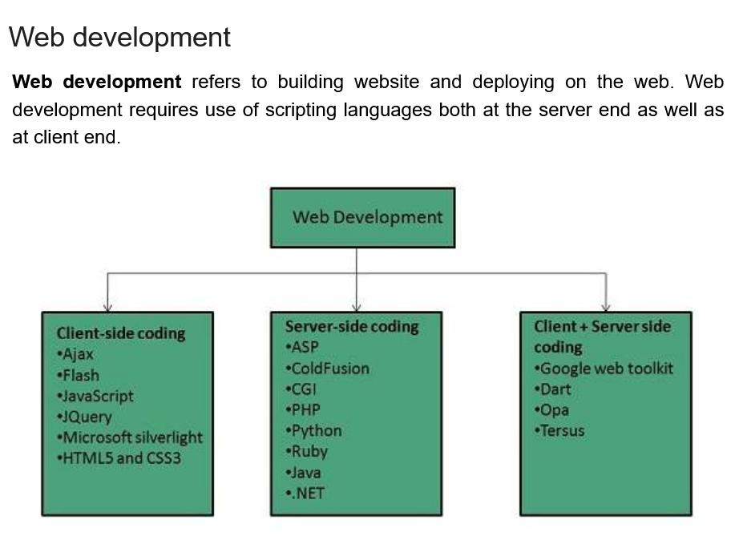

Slide 22
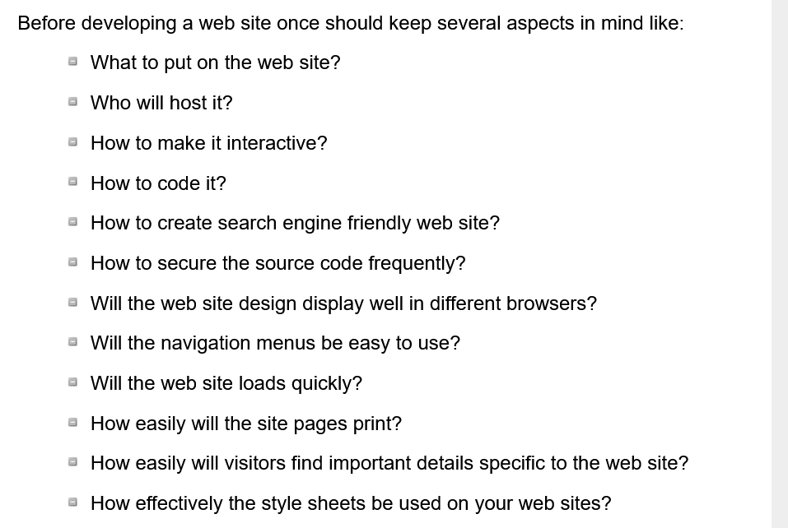

Slide 23
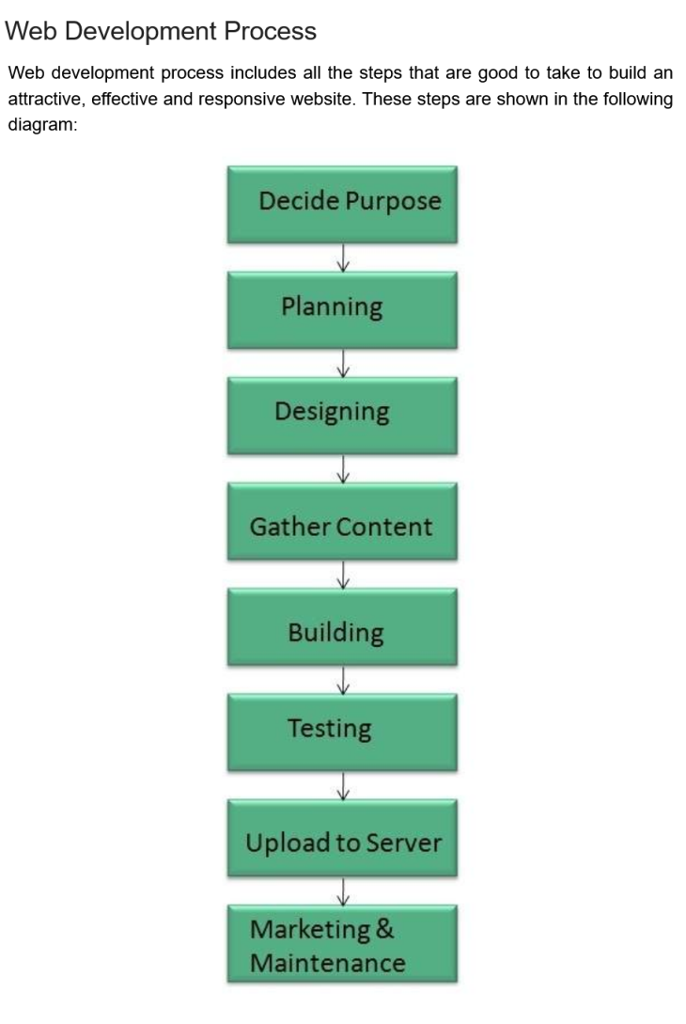

Slide 24
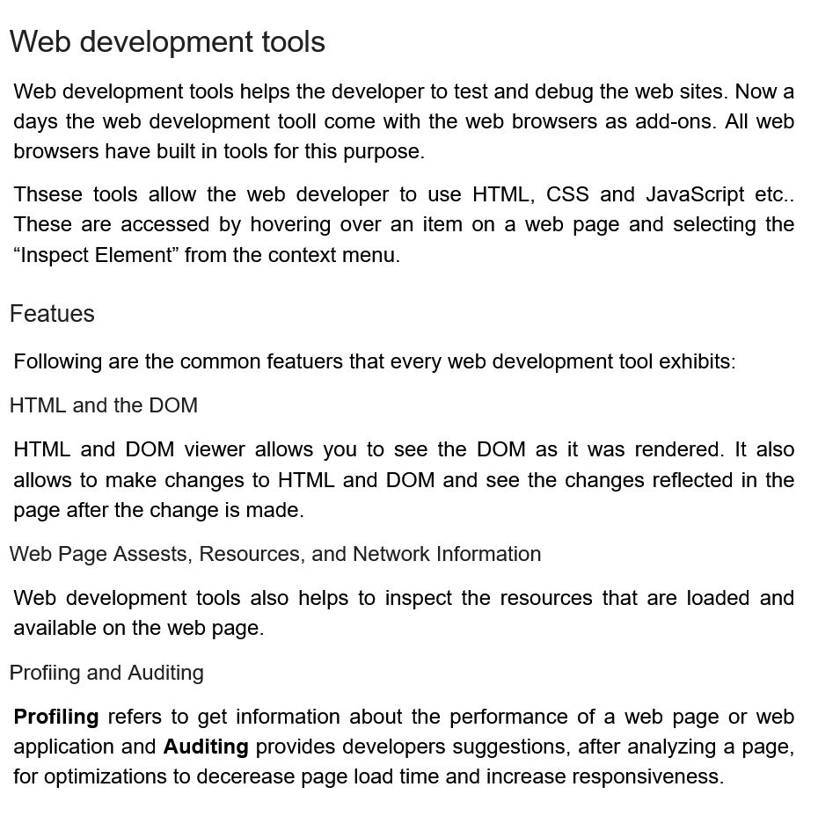

Slide 25
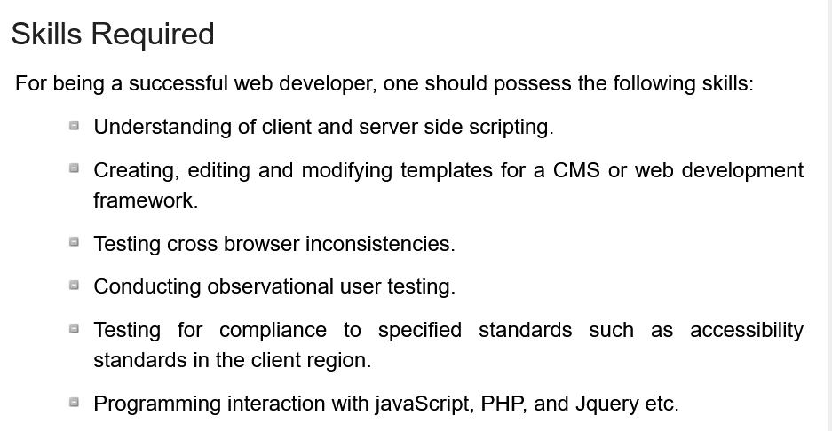

Slide 26
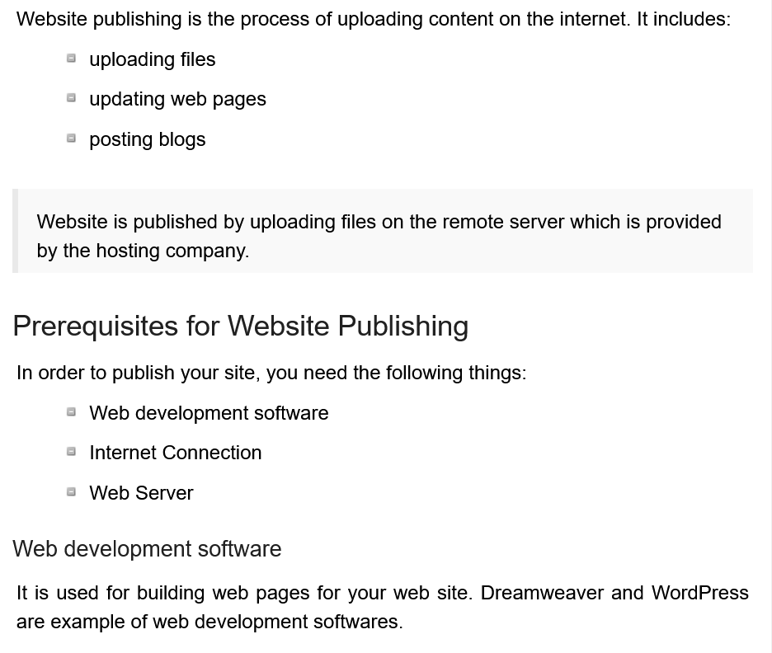

Slide 27
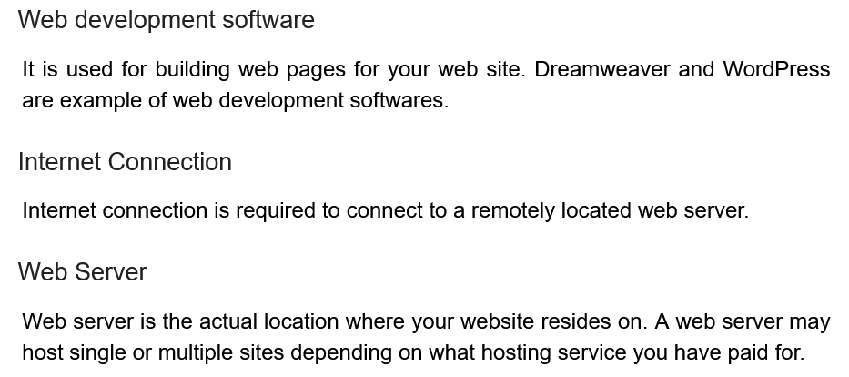

Slide 28
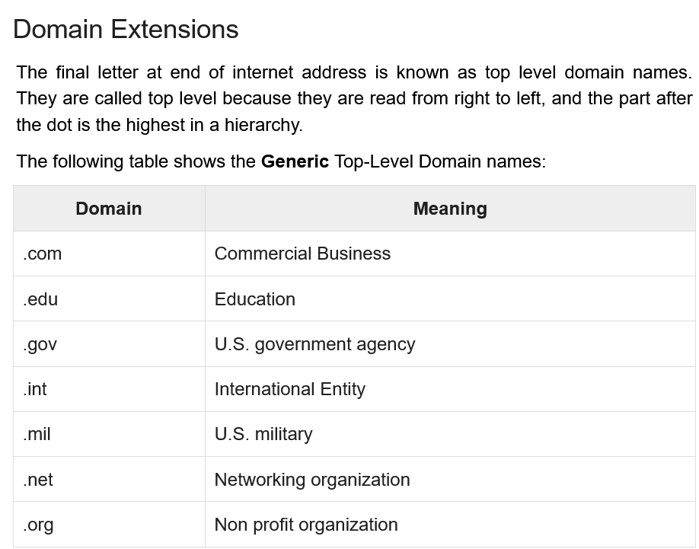

Slide 29
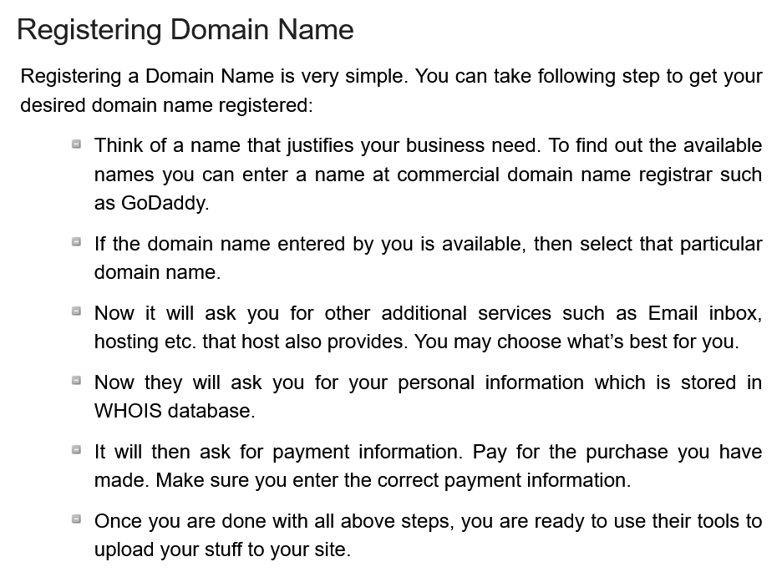

Slide 30
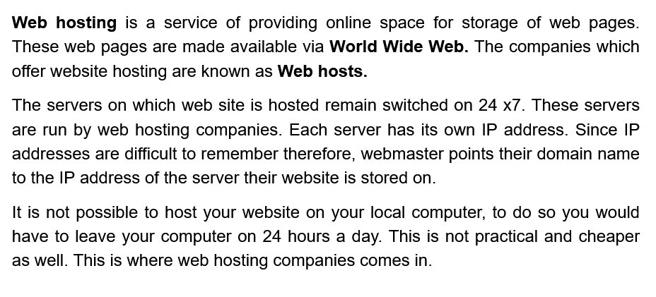

Slide 31
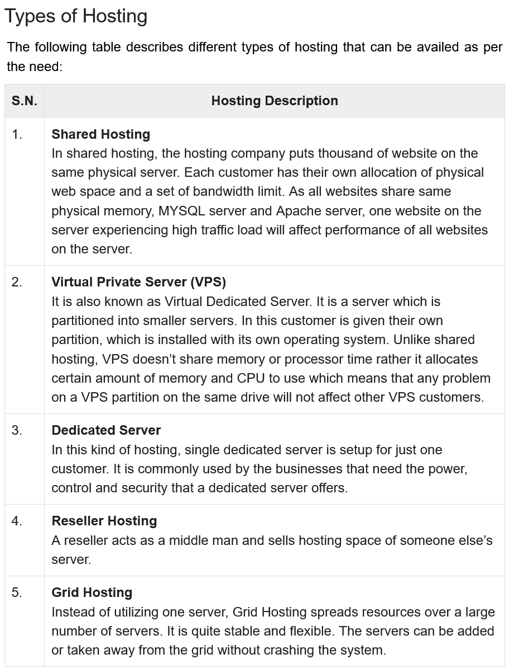

Slide 32
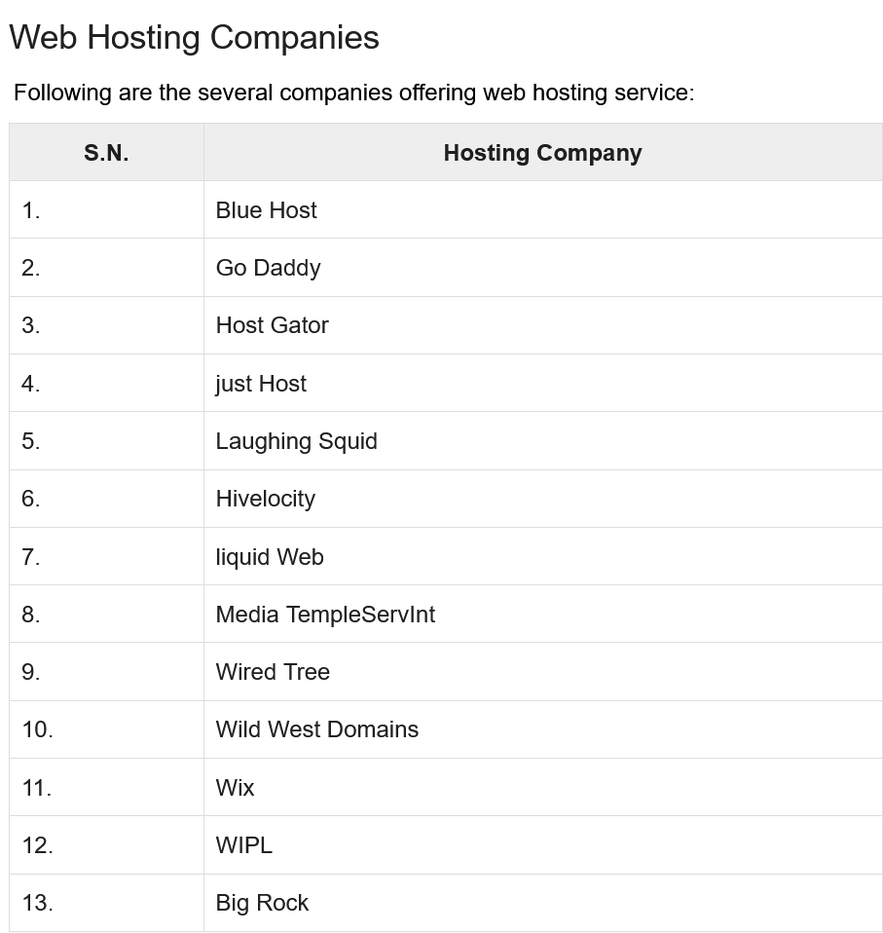

Slide 33
Multipurpose Internet Mail Extension (MIME) is a standard which was proposed by Bell Communications in 1991 in order to expand limited capabilities of email. MIME is a kind of add on or a supplementary protocol which allows non-ASCII data to be sent through SMTP. It allows the users to exchange different kinds of data files on the Internet: audio, video, images, application programs as well.
Why do we need MIME? Limitations of Simple Mail Transfer Protocol (SMTP):
SMTP has a very simple structure
It’s simplicity however comes with a price as it only send messages in NVT 7-bit ASCII format.
It cannot be used for languages that do not support 7-bit ASCII format such as- French, German, Russian, Chinese and Japanese, etc. so it cannot be transmitted using SMTP. So, in order to make SMTP more broad we use MIME.
It cannot be used to send binary files or video or audio data.

Slide 34
MIME
Purpose and Functionality of MIME – Growing demand for Email Message as people also want to express in terms of Multimedia. So, MIME another email application is introduced as it is not restricted to textual data.
MIME transforms non-ASCII data at sender side to NVT 7-bit data and delivers it to the client SMTP. The message at receiver side is transferred back to the original data. As well as we can send video and audio data using MIME as it transfers them also in 7-bit ASCII data.

Slide 35
Features of MIME –
It is able to send multiple attachments with a single message.
Unlimited message length.
Binary attachments (executables, images, audio, or video files) which may be divided if needed.
MIME provided support for varying content types and multi-part messages.
Working of MIME – Suppose a user wants to send an email through user agent and it is in a non-ASCII format so there is a MIME protocol which converts it into 7-bit NVT ASCII format. Message is transferred through e-mail system to the other side in 7-bit format now MIME protocol again converts it back into non-ASCII code and now the user agent of receiver side reads it and then information is finally read by the receiver. MIME header is basically inserted at the beginning of any e-mail transfer.
MIME with SMTP and POP – SMTP transfers the mail being a message transfer agent from senders side to the mailbox of receiver side and stores it and MIME header is added to the original header and provides additional information. while POP being the message access agent organizes the mails from the mail server to the receivers computer. POP allows user agent to connect with the message transfer agent.

Slide 36
MIME
MIME Header: It is added to the original e-mail header section to define transformation. There are five headers which we add to the original header:
MIME Version – Defines version of MIME protocol. It must have the parameter Value 1.0, which indicates that message is formatted using MIME.
Content Type – Type of data used in the body of message. They are of different types like text data (plain, HTML), audio content or video content.
Content Type Encoding – It defines the method used for encoding the message. Like 7-bit encoding, 8-bit encoding, etc.
Content Id – It is used for uniquely identifying the message.
Content description – It defines whether the body is actually image, video or audio.

Slide 37
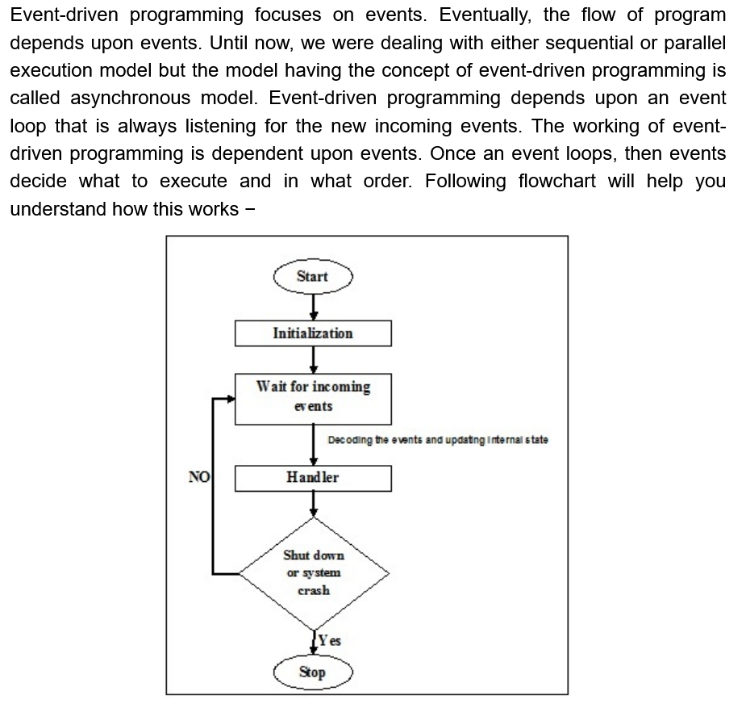

Slide 38
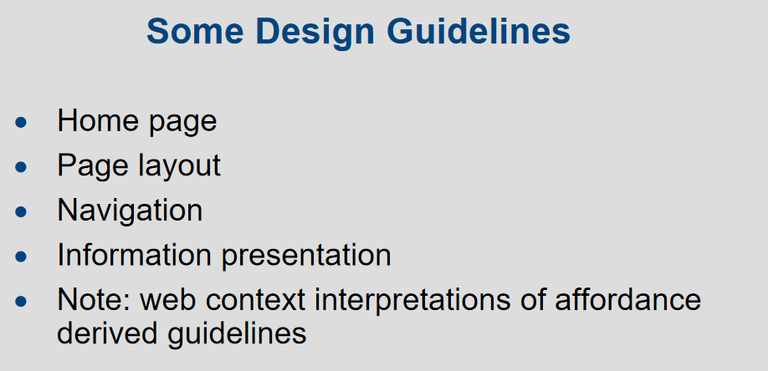
Website Design Guidelines

Slide 39
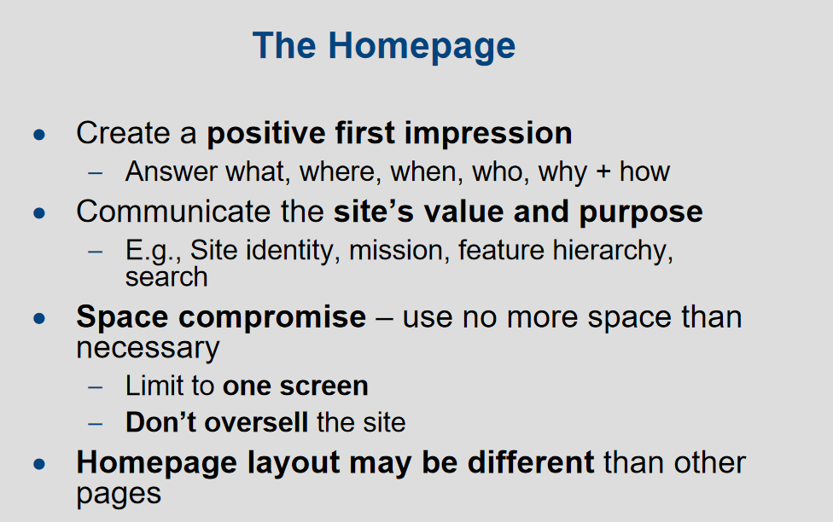

Slide 40
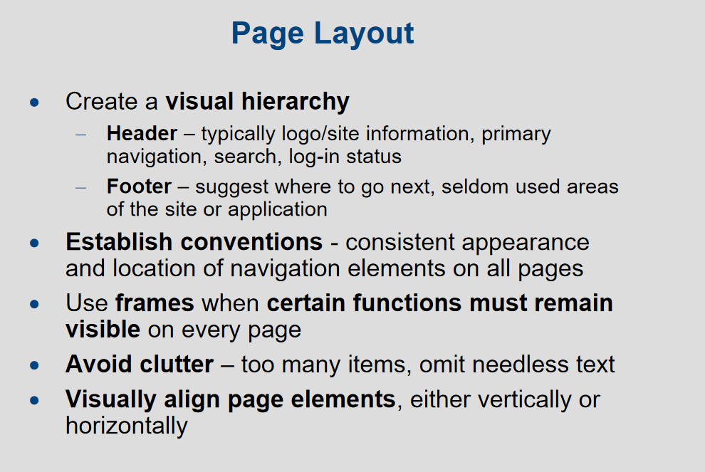

Slide 41
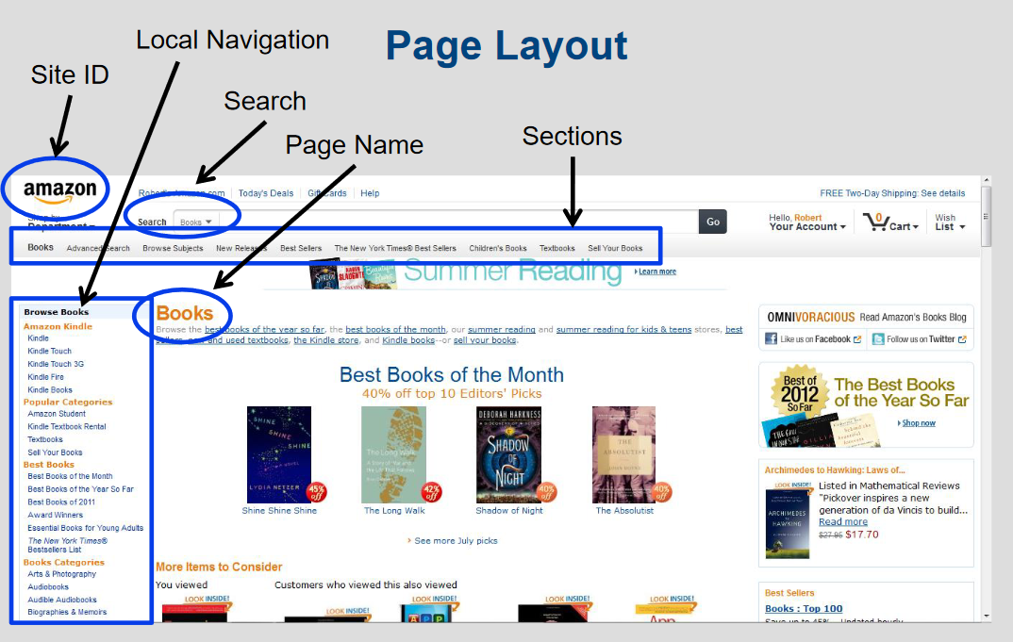

Slide 42
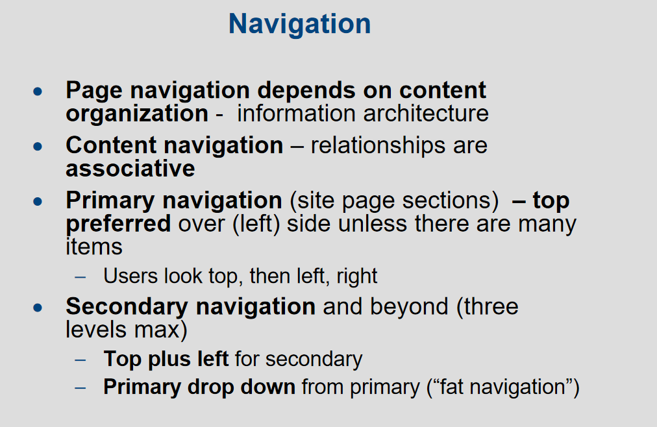

Slide 43
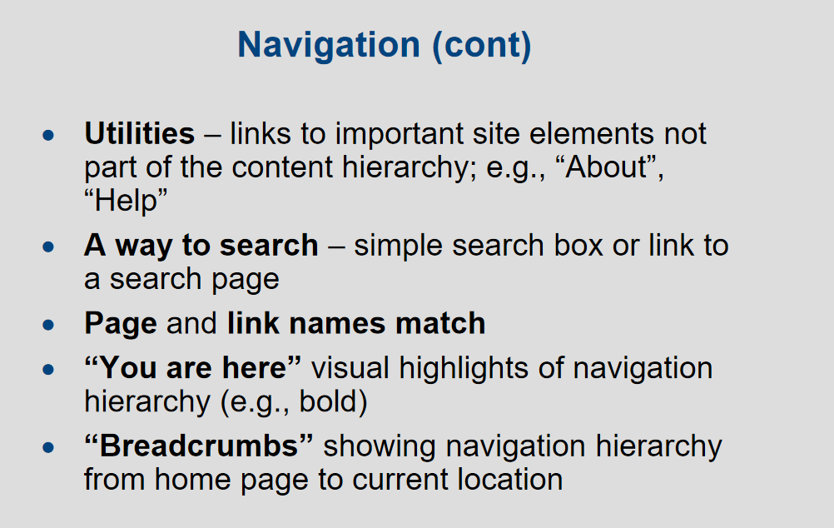

Slide 44
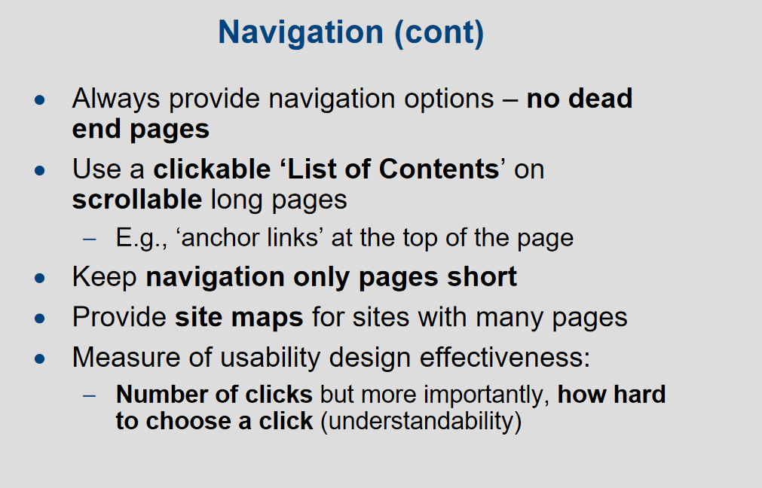

Slide 45
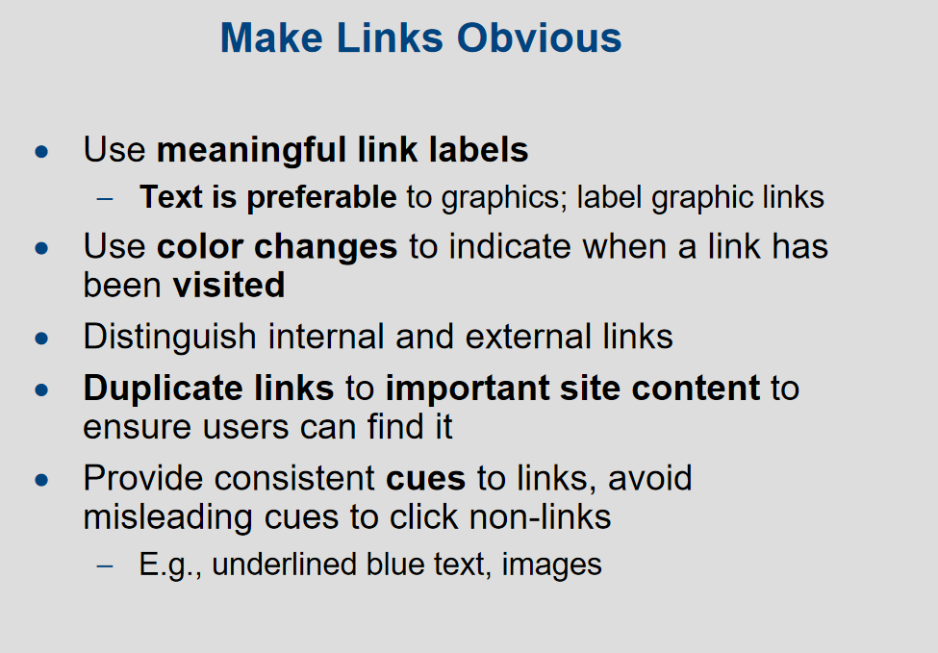

Slide 46
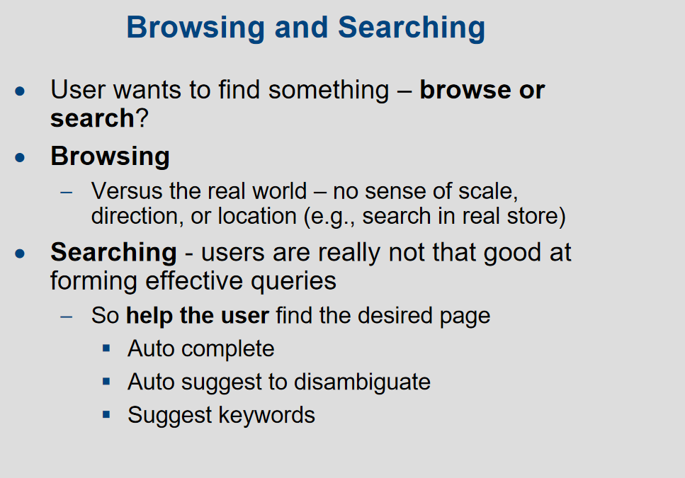

Slide 47
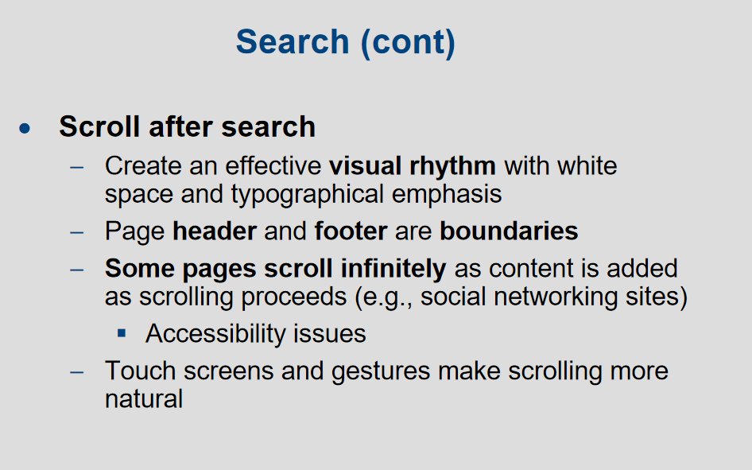

Slide 48
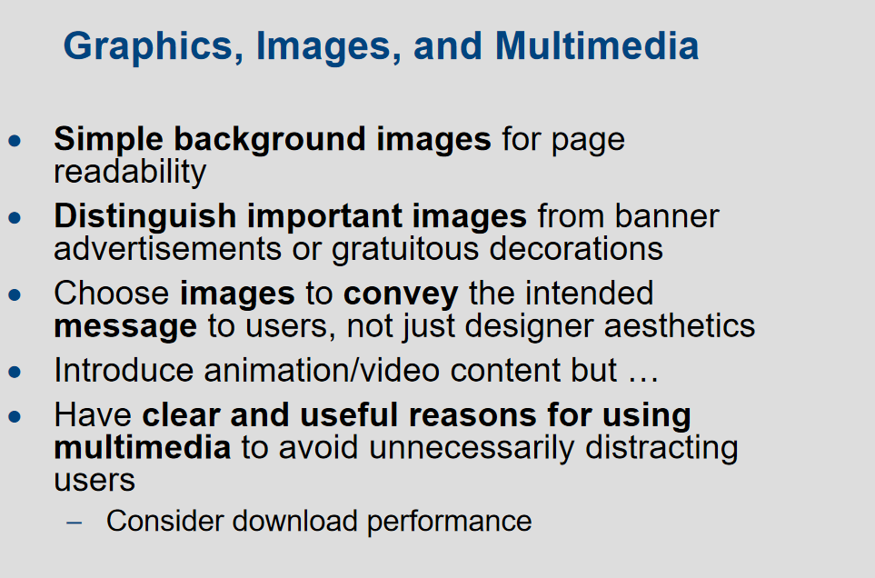

Slide 49
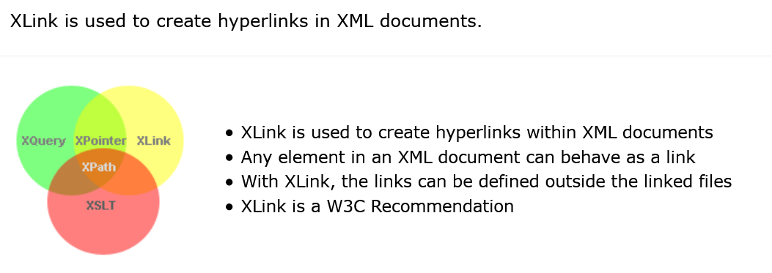
XLink

Slide 50
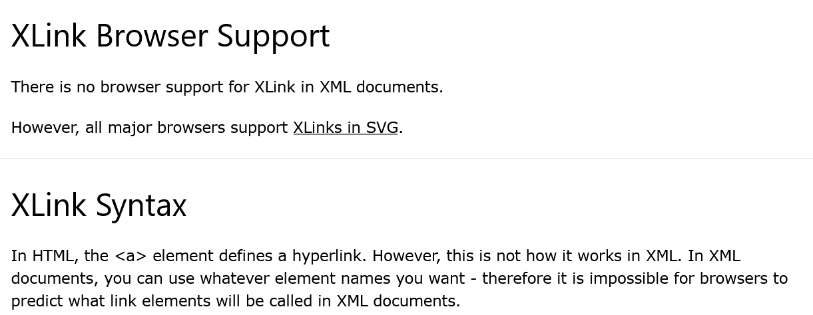
XLink

Slide 51
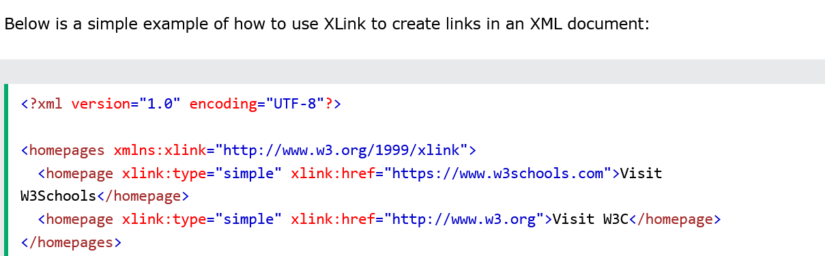
XLink

Slide 52
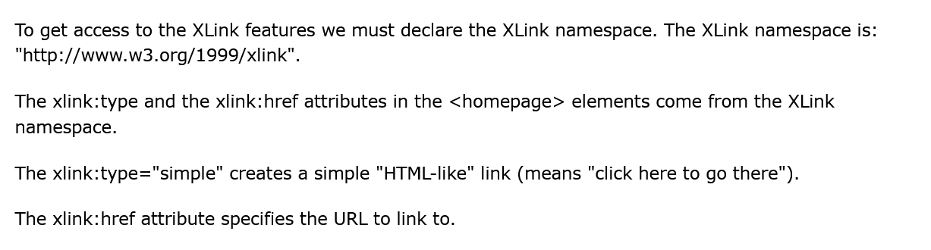
XLink

Slide 53
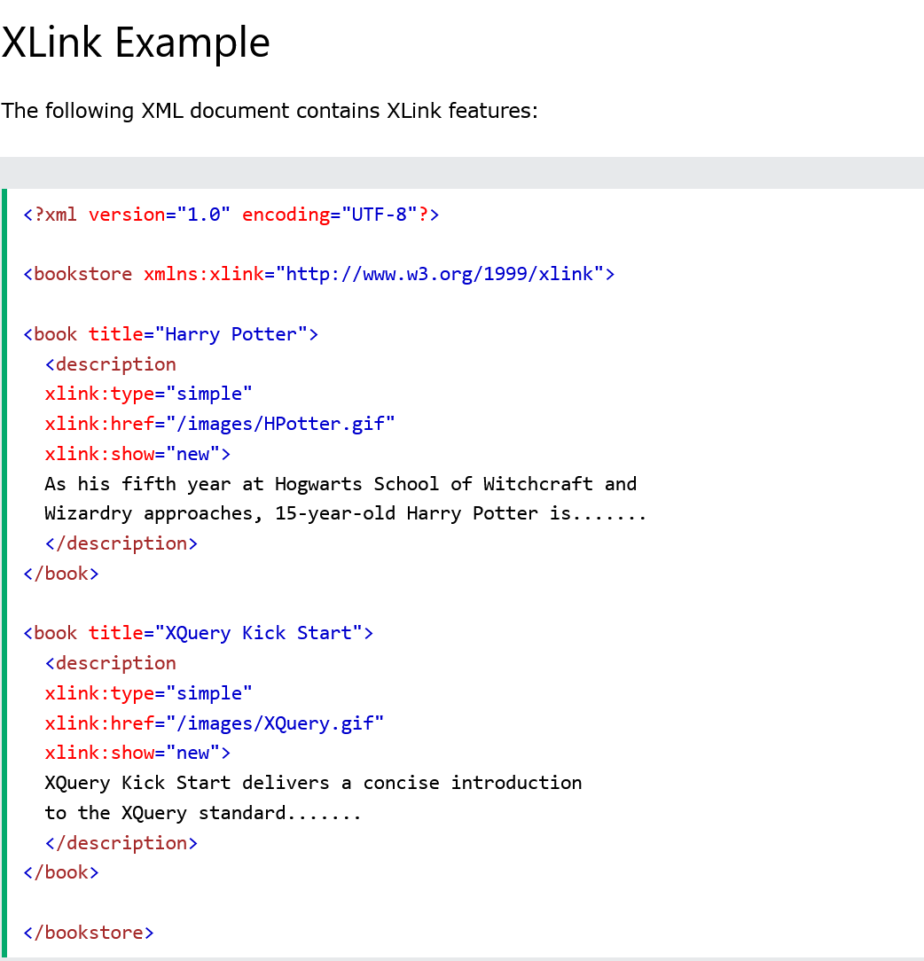

Slide 54
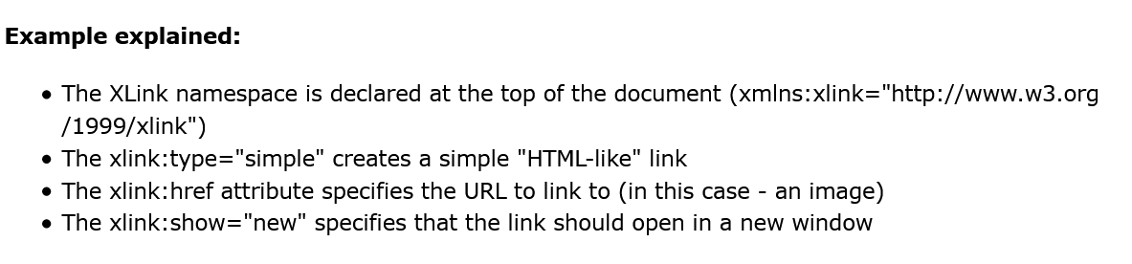

Slide 55
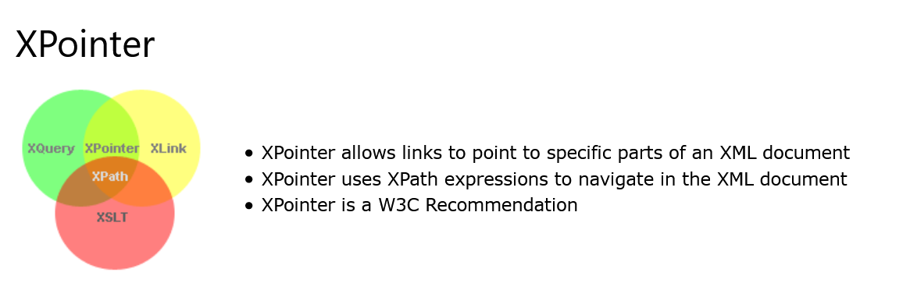
XPointer

Slide 56


Slide 57


Slide 58


Slide 59


Slide 60
XML Validator
Use our XML validator to syntax-check your XML.
Well Formed XML Documents
An XML document with correct syntax is called "Well Formed".
The syntax rules are:
XML documents must have a root element
XML elements must have a closing tag
XML tags are case sensitive
XML elements must be properly nested
XML attribute values must be quoted
<?xml version="1.0" encoding="UTF-8"?> <note> <to>Tove</to> <from>Jani</from> <heading>Reminder</heading> <body>Don't forget me this weekend!</body> </note>

Slide 61

XML Validator

Slide 62

XML Validator

Slide 63
Difference Between Programming, Scripting, and Markup Languages
When it comes to making a website or app coding involves basically three types of languages i.e the programming language, Scripting Language and Markup Language.
There are a lot of people who consider coding as just developing or making a website but they need to understand every single language fits into a particular category and we need to know which category that language fits into.
We will discuss in detail about the difference between these three main categories or pillars of a website or an app i.e. Programming language, Scripting Language and Markup Language.

Slide 64
Difference Between Programming, Scripting, and Markup Languages
Programming language: In simple terms, programming languages are set of instructions or code which tells a computer what it needs to do. So basically, we provide a logic or instruction to the computer to perform some task to get the desired output from it.
When we need to write a CD or burn a CD or when we need to paste something in pen drive these all instruction is given through some software which involves some instructions or set of code and this software communicate to the hardware.
Programming languages are high-level languages that need to be converted into machine level language because a computer can only understand machine level language or binary language (0 and 1).
So we write the instructions in human-readable form and then we hit the compile button to convert this into machine level language which a computer can understand and then the computer performs the task.
This conversion is done by the compiler which scans the complete code in one go and if it finds any error it immediately throws all errors. Examples are Java, C, C++, C#. Programming languages are most widely used to make software or drivers.

Slide 65
Difference Between Programming, Scripting, and Markup Languages
Scripting Language: As the name suggest, it’s all about giving the script to perform some certain task.
Scripting languages are basically the subcategory of programming languages which is used to give guidance to another program or we can say to control another program, so it also involves instructions.
It basically connects one language to one another languages and doesn’t work standalone. Javascript, PHP, Perl, Python, VBScript these all are the examples of scripting language.
Scripting languages need to be interpreted (Scanning the code line by line, not like compiler in one go) instead of compiled.
There is no scope of compiler in scripting languages. Scripting languages are most widely used to create a website.

Slide 66
Difference Between Programming, Scripting, and Markup Languages
Markup Languages: Markup languages are completely different from programming languages and scripting languages. Markup languages prepare a structure for the data or prepare the look or design of a page.
These are presentational languages and it doesn’t include any kind of logic or algorithm, for example, HTML. HTML is not asking any kind of question to the computer or it’s not comparing things and it’s not asking any logical question.
It’s just used to represent a view inside a web browser. It tells the browser how to structure data for a specific page, layout, headings, title, table and all or styling a page in a particular way.
So basically it involves formatting data or it controls the presentation of data. Examples of Markup languages are HTML, CSS or XML. These languages are most widely used to design a website.

Slide 67


Slide 68


Slide 69


Slide 70


Slide 71


Slide 72


Slide 73


Slide 74


Slide 75


Slide 76


Slide 77


Slide 78

PHP - AJAX and MySQL

Slide 79


Slide 80


Slide 81


Slide 82


Slide 83


Slide 84


Slide 85


Slide 86


Slide 87


Slide 88



